Slide 2
Gratitude & Connectedness
Notes:
Motivosity is a modern employee engagement platform. (the smiley face is on this slide to remind you that one of our key deliverables is to be likable. We’re not talking about the smiley face, but when you see it, remember to smile and have fun).
When you get Motivosity, you get motivated teams. Get it? Motivosity = Motivated Teams. Every element of our solution is designed to increase team motivation. The solutions we create are streamlined and modern. Our software is designed to be a positive experience for every user. The standard we hold out for ourselves is that our software has to deliver a big impact for the company, but never feel like a chore for the user. How can we have happy, motivated teams if we force them to do things they don’t love?

Slide 3
Founded by Scott Johnson in 2013
Founder and former CEO of Workfront, an Adobe company
Why do we exist
Help people be happier about being at work
What do we do
Appreciate employees build a strong community, help managers be better managers
Our Values
Stay Young
Love What You Do
Serve Always
95%
52%
77%
98%
Avg Employee adoption
(with no decrease over time)
Increase in eNPS
Increase to employee intent to stay
Customer retention rate

Slide 4
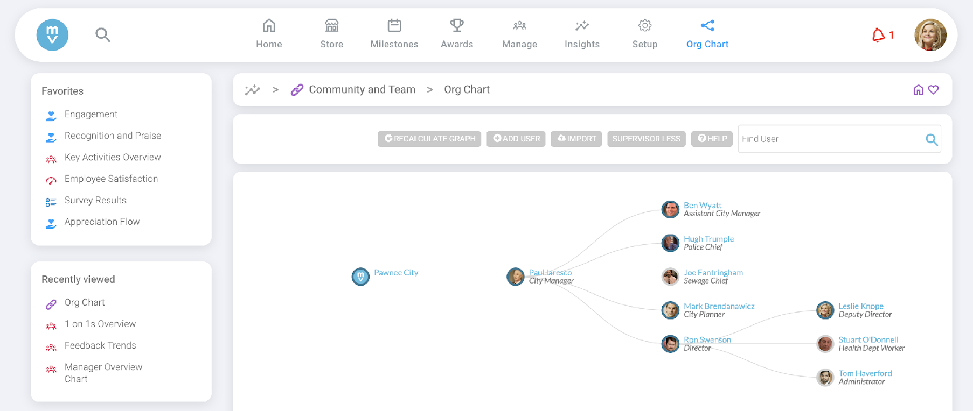
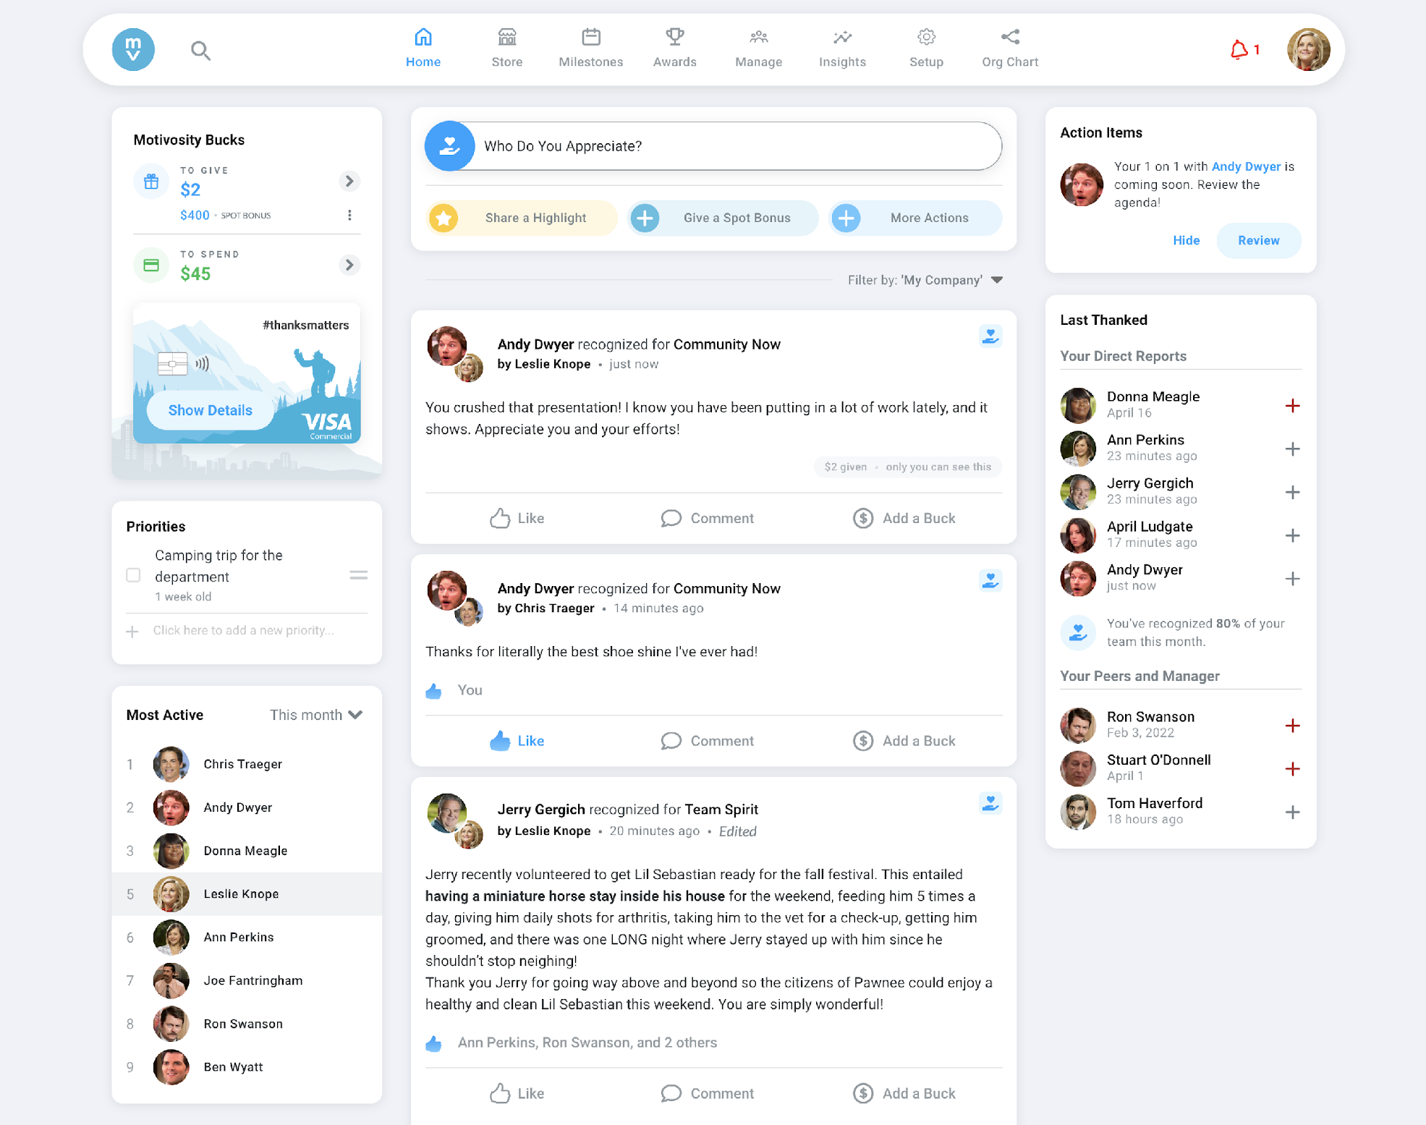
Notes:
Connect helps teams understand and appreciate each other. It provides a social platform for appreciations, highlights, and announcements as well as social tools like personality profiles, interest groups, histories, and org charts.

Slide 5
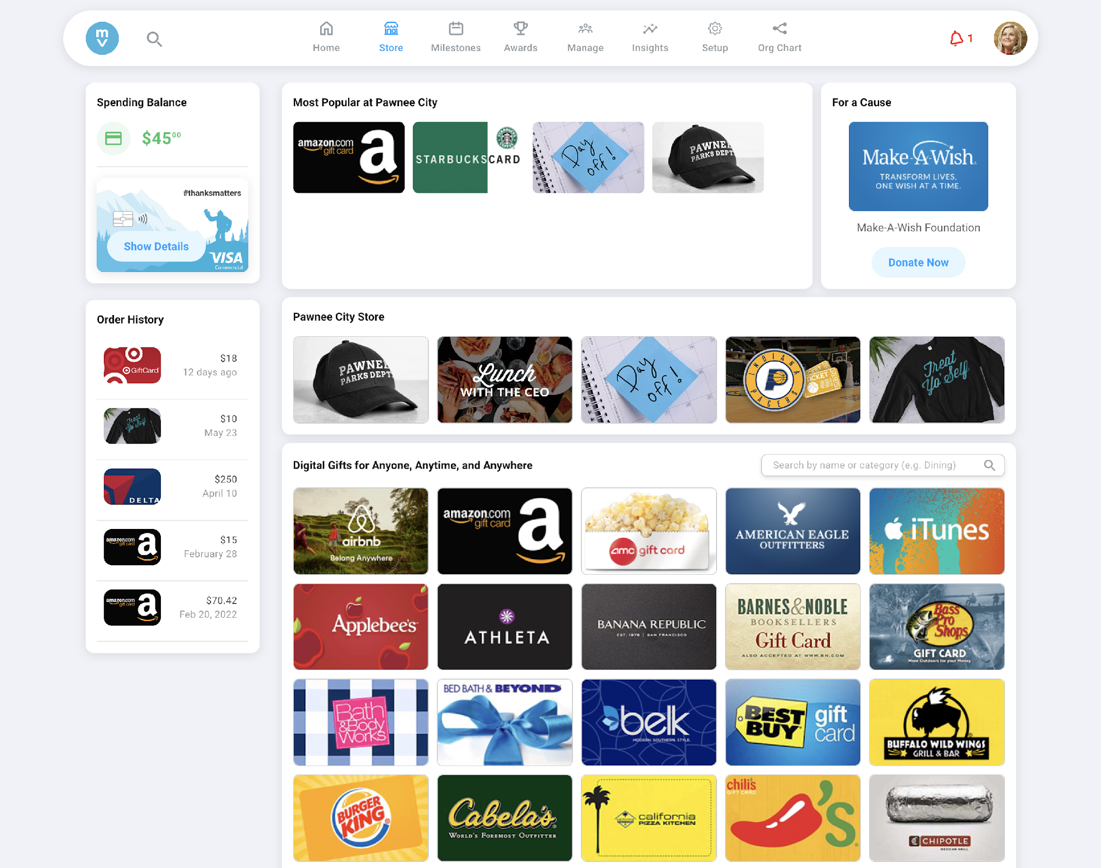
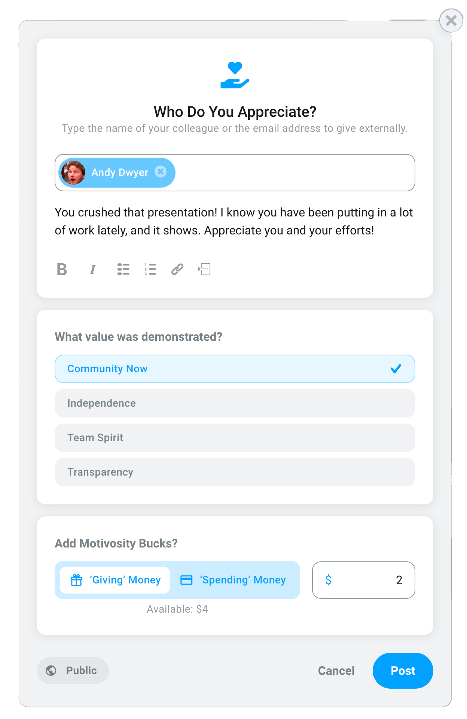
Notes:
Recognize helps companies increase gratitude with rewards and recognition. It provides influence currency, spot bonus and awards programs and rewards.

Slide 6
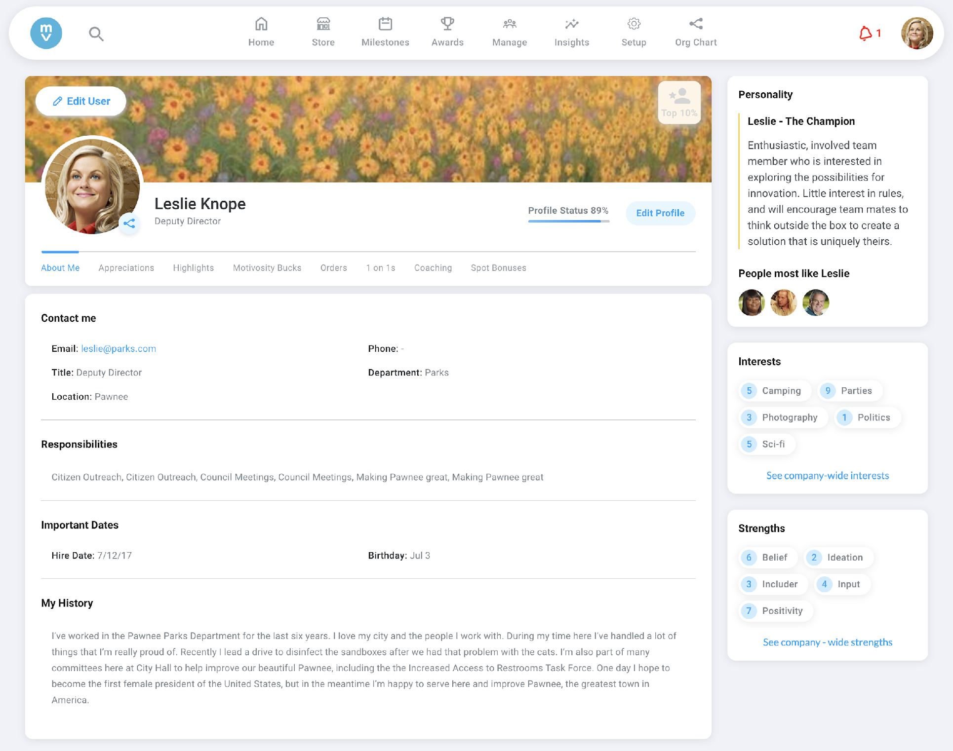
Let’s Get Started!
Fill out your personal profile
Name
Birthday
History
Interests
Personality
Job
Responsibilities
Preferences

Slide 7
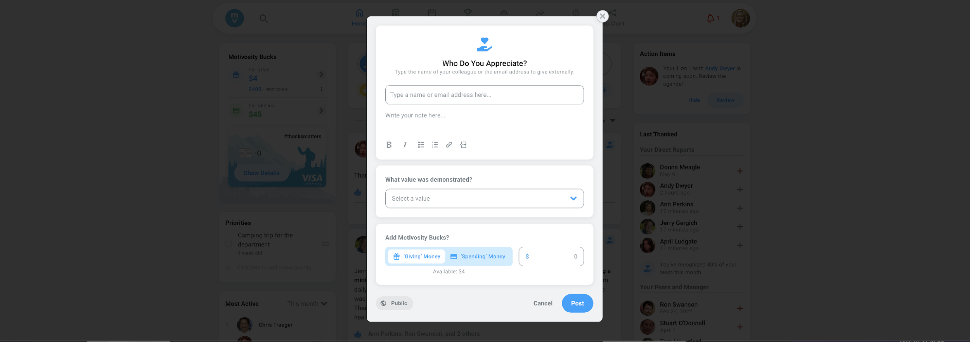
Start Appreciating
See Something Say Something
Select “Appreciate Someone” on the home page.
Enter the name(s) of people you’d like to appreciate.
Note: you can appreciate multiple people at the same time.
Enter your appreciation.
Select a value that most aligns with why you are appreciating them.
Enter a dollar value you would like to give.
Note: you can give $0.
Hit the post button.

Slide 8
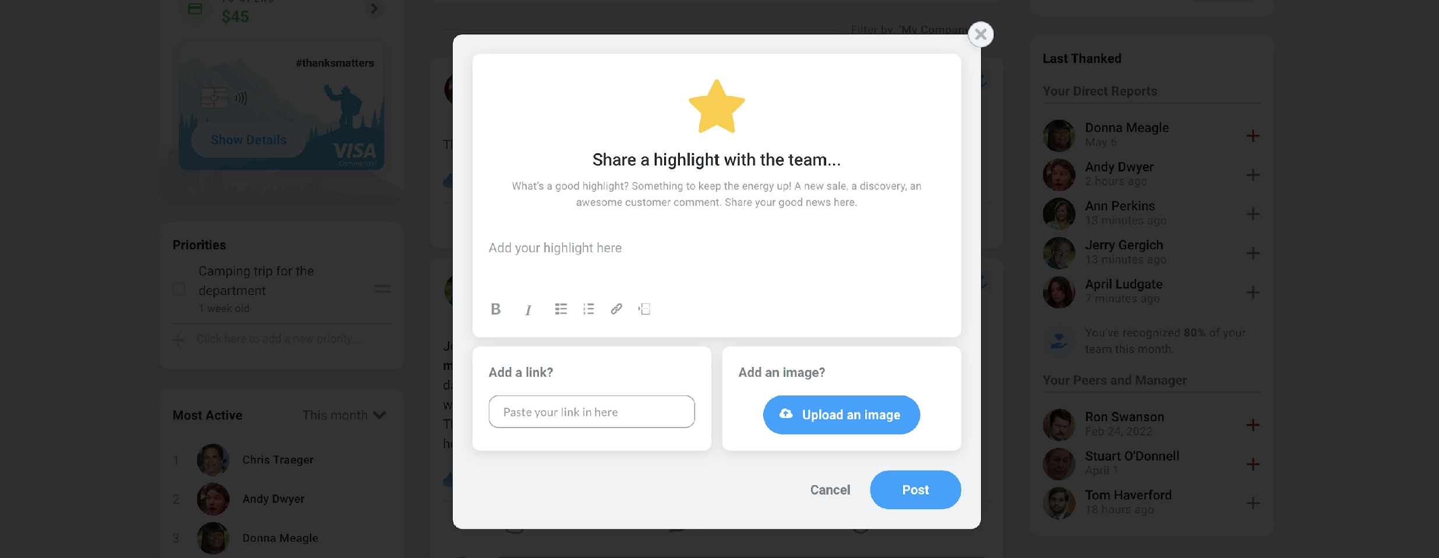
Share a Highlight
See Something Say Something
Select “Share a Highlight” on the home page.
Enter your highlight.
Add an image if needed.
Add a link if needed.
Hit the post button.

Slide 9
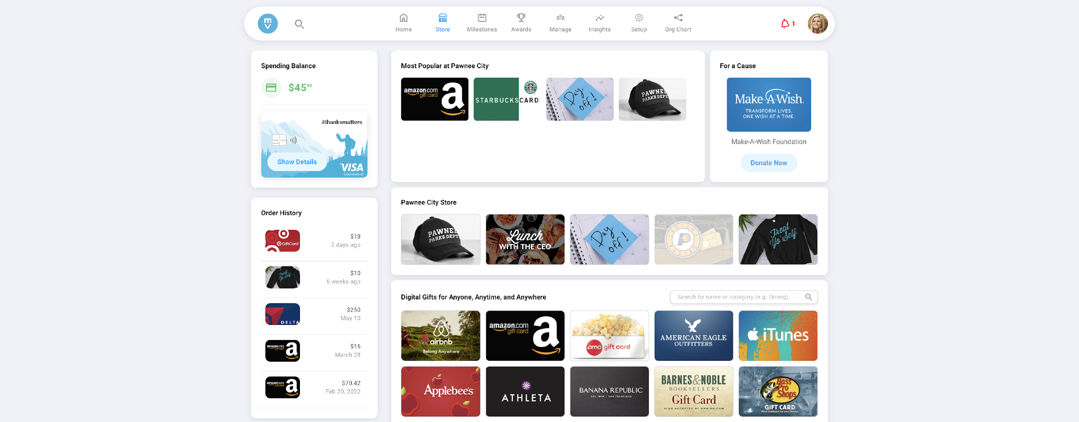
Spend your Motivosity Bucks
What? Where? When?
Spend the money you’ve received in a way that’s meaningful to you.
Redeem E Gifts
Donate to charity
Buy company swag
Use your ThanksMatters Card
US & CAN have access to a physical card
Add to Mobile Wallet
Make purchases online
Be rewarded on their own terms whether that means a cup of coffee, school books, or a new surfboard—you have the power to choose. Since we use dollars instead of points, the ThanksMatters Card is as good as cash and works anywhere a VISA is accepted.

Slide 10
Building a culture of gratitude begins with you!

